Slide 1
Physical Chemistry
Ying Hu
(Fifth edition)
Bilingual Program
版权所有：华东理工大学物理化学教研室

Slide 2
Part V Extension
Chapter 16
Electrolyte Solutions
Bilingual Program
版权所有：华东理工大学物理化学教研室

Slide 3
Framework of the Chapter
Electrolyte solutions
properties
equilibrium
transport
reaction-rate
experimental
semi-empirical
theoretical

Slide 4
Framework of the Chapter
Electrolyte solutions
Equilibrium Properties
Transport Properties
Reaction-Rate Properties
Mechanism of
Electric
Conductance
Ionic Reactions
in Solution
Diversity of
Activities
Debye-Hückel
Theory
Semi-Empirical
Methods
Electric
Conductivity
Diffusion
Coefficients
Applications
Theoretical
Semi-Empirical
Methods

Slide 5
16. Electrolyte Solutions
Framework of the Chapter
    16.1 Introduction
    I. Equilibrium Properties of Electrolyte.
    16.2 Activities of Electrolyte Solutions
    16.3 Theories and Semi-Empirical Methods
    16.4 Applications
    II. Transport Properties of Electrolyte Solutions
    16.5 Mechanism of Electric Conductance of Electrolyte Solutions
    16.6 Mobility and Transference Number of Ions
    16.7 Electric Conductivity
    16.8 Other Applications of Electric Conductance
    16.9 Diffusion in Electrolyte Solutions
    16.10 Theoretical and Semi-Empirical Methods
    III. Reaction-Rate Properties of Electrolyte Solutions
    16.11 Ionic Reaction in Solution

Slide 6
16.1 Introduction
Electrolytes and Electrolyte Solutions
A solution in which the solute is completely or partially dissociated into ions after dissolving in solvent is called an electrolyte solution. The solute is called the electrolyte.
First-Kind Electrolyte Solutions
The solute dissociates completely, neither the undissociated solute molecules nor the associates of cation and anion are found in the solution.
Second-Kind Electrolyte Solutions
The solute dissociates partially. The undissociated solute molecules with atoms combined by covalent bonds, or the ionic pairs formed by the association of cation and anion are found in the solution.

Slide 7
16.1 Introduction
Electrolytes and Electrolyte Solutions
First-Kind Electrolyte Solutions
Second-Kind Electrolyte Solutions
The solute dissociates partially
The solute dissociates completely
Aqueous solutions of strong acids, weak acids, weak bases, sulphates of bivalent metals and strong bases
Aqueous solutions of the halides of the alkaline, alkaline-earth and transition metals.
Strong Electrolytes and Weak Electrolytes
The undissociated solute molecules can be found in dilute concentration are called the weak electrolytes. Others are called the strong electrolytes.

Slide 8
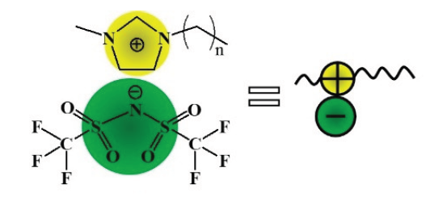
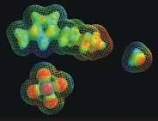
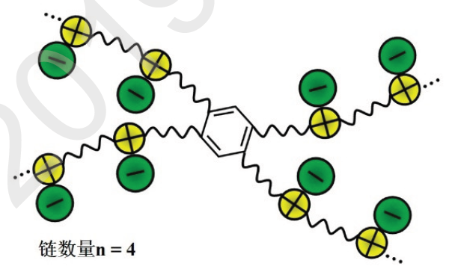
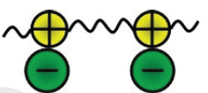
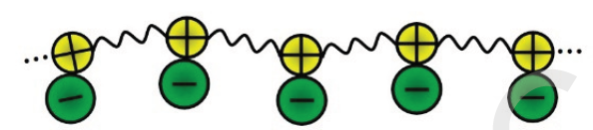
16.1 Introduction
Ionic Liquid
An ionic liquid (IL) is a salt in the liquid state, whose melting point is below some arbitrary temperature, such as 100 ºC. ILs are largely made of ions and short-lived ion pairs.

Slide 9
16.1 Introduction
Properties of Electrolyte Solutions
Equilibrium Properties
The activities of the electrolyte solutions are mainly determined by the electrostatic interactions among ions and have many peculiarities.
Transport Properties
The most prominent is the ionic migration in the electric field.
Reaction Properties
The rate constants of ionic reactions are also closely related with the ionic charges.

Slide 10
I. Equilibrium Properties of Electrolyte
Bilingual Program
版权所有：华东理工大学物理化学教研室

Slide 11
16. Electrolyte Solutions
    I. Equilibrium Properties of Electrolyte
    16.2 Activities of Electrolyte Solutions
    16.3 Theories and Semi-Empirical Methods
    16.4 Applications

Slide 12
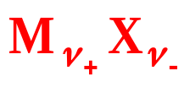
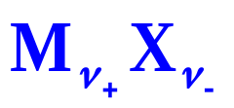
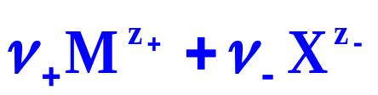
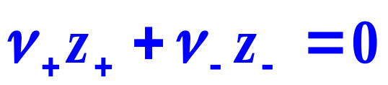
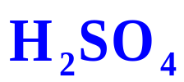
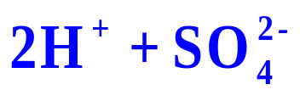
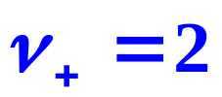

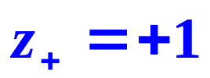
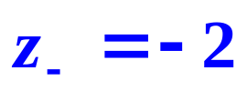
16.2 Activities of Electrolyte Solutions
1. Activities of Various Components
Components
Generally, all electrolyte solutions are the second-kind. Suppose the electrolyte is
Dissociation
Electro neutrality
Where z₊ (positive) and z₋(negative) are the ionic charge numbers ν₊ and ν₋ are the corresponding stoichiometry numbers.
For example

Slide 13
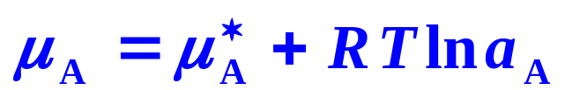
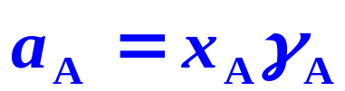
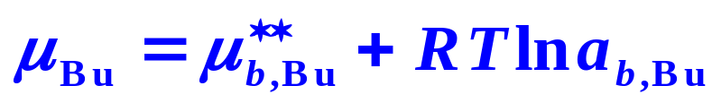
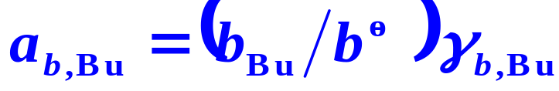
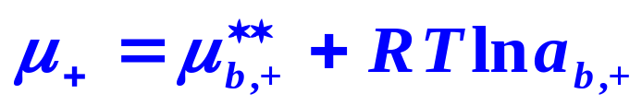
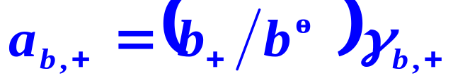
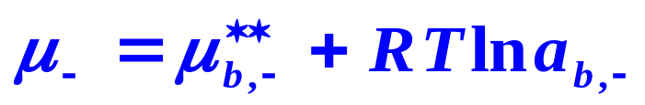
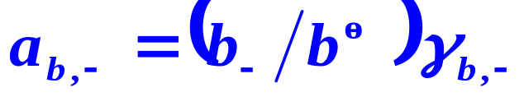
16.2 Activities of Electrolyte Solutions
1. Activities of Various Components
Chemical Potentials of Components
There are four components in the solution, the solvent, A, the undissociated electrolyte, Bu, the cation, +, and the anion, − .
Activities of Components

Slide 14
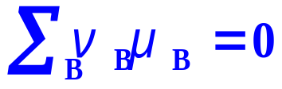
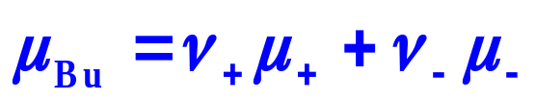
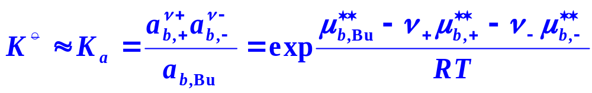
16.2 Activities of Electrolyte Solutions
Standard Equilibrium Constant of Dissociation Equilibrium

Slide 15
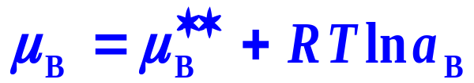


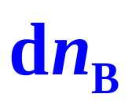
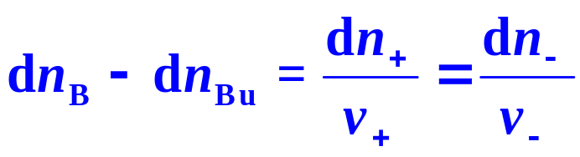
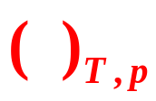
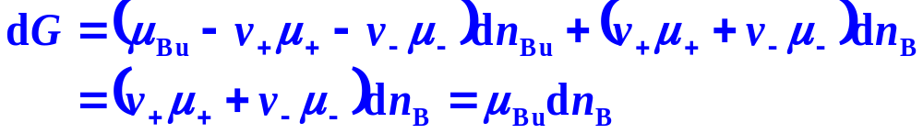
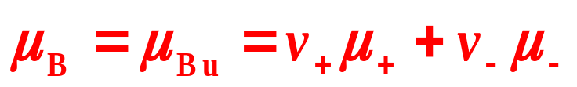
16.2 Activities of Electrolyte Solutions
2. A Phenomenological Approach
Chemical Potential μ_{B} of Electrolyte as a Whole

Slide 16


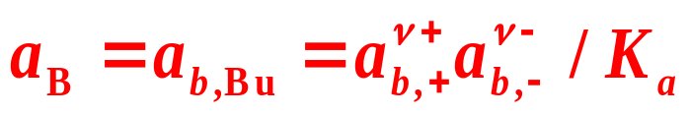

16.2 Activities of Electrolyte Solutions
Activity a_{B} of Electrolyte as a Whole
The reference state of a_{B} The solute of an ideal dilute solution of an undissociated electrolyte with a molarity of
The activity a_{B} is the same as that of the undissociated electrolyte a_{b,Bu}
The chemical potential μ_{B} of the electrolyte as a whole equals that of the undissociated electrolyte μ _{Bu}

Slide 17
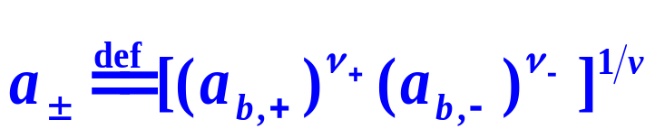
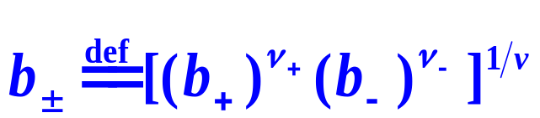
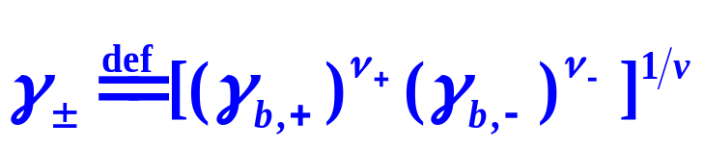
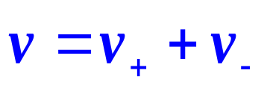

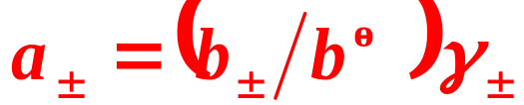

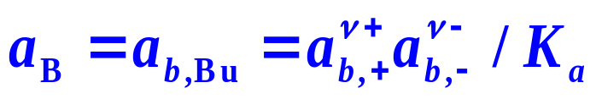
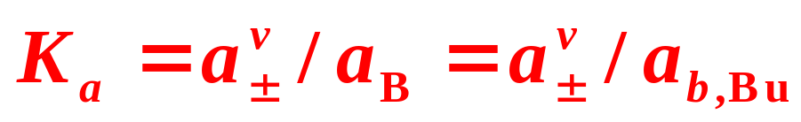
16.2 Activities of Electrolyte Solutions
3. Mean Ionic Activity
In electrolyte solutions, cations and anions always exist simultaneously, it is difficult to determine the activity of a single kind of ions.
Mean ionic activity
Mean ionic molarity
Mean ionic activity factor

Slide 18
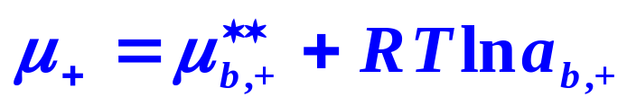

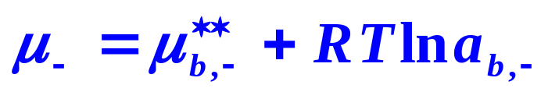
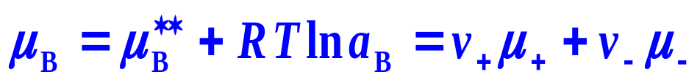

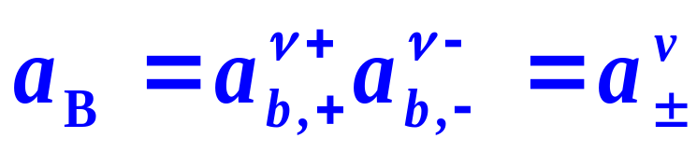
16.2 Activities of Electrolyte Solutions
4. Special Common Practice for First-Kind Electrolyte Solutions
Activities of Solvent and Ions
Activity of Electrolyte as a Whole
First-Kind Electrolyte

Slide 19
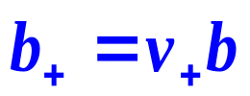
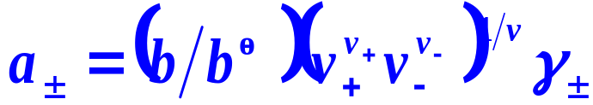
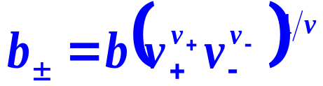
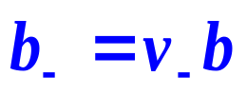
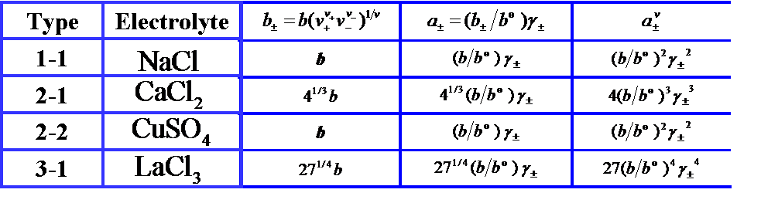

16.2 Activities of Electrolyte Solutions
4. Special Common Practice for First-Kind Electrolyte Solutions
Relations between b±, a± and b for electrolyte solutions of various valence types

Slide 20
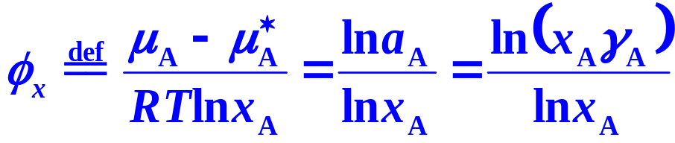
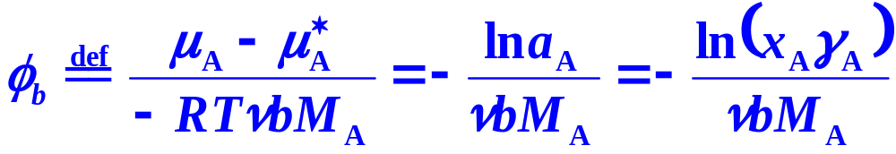

16.2 Activities of Electrolyte Solutions
5. Osmotic Factor of Solvent
Rational Osmotic Factor φ_{x}
Practical Osmotic Factor φ_{b}
Relation between φ_{b} and φ_{x}
For a very dilute solution，φ_{x} ≈φ_{b}
For a infinite dilute solution, φ_{x}=φ_{b}=1.

Slide 21

16.2 Activities of Electrolyte Solutions
6. Sources of Activity Factors and Osmotic Factors
Experimental, semi-empirical and theoretical.
Practical osmotic factors and mean activity coefficients at 25 ℃
As for φ, it can be calculated from γ± by using the Gibbs-Duhem equation.

Slide 22






16.2 Activities of Electrolyte Solutions
Ionic Strength
or
For a single first-kind electrolyte solution
For a mixture of first-kind electrolyte solution
or

Slide 23



16.2 Activities of Electrolyte Solutions
6. Sources of Activity Factors and Osmotic Factors
In the dilute region

Slide 24

16.2 Activities of Electrolyte Solutions
Example 1
Calculate the mean ionic concentration, the mean ionic activity, the electrolyte activity, the solvent activity and activity factor of an aqueous MgCl₂ solution of b=1.20mol⋅kg⁻¹ at 25°C
Solution:
For MgCl₂, ν₊=1, ν₋=2, ν = 3
From Table 16-2, γ±=0.630, φ_{b}=1.184.

Slide 25

16.2 Activities of Electrolyte Solutions
Example 2
Calculate the ionic strength of two aqueous solutions of KCl and MgCl₂ of b=1.20mol⋅kg⁻¹ at 25°C, respectively.
Solution:

Slide 26
16. Electrolyte Solutions
    I. Equilibrium Properties of Electrolyte
    16.2 Activities of Electrolyte Solutions
    16.3 Theories and Semi-Empirical Methods
    16.4 Applications

Slide 27
16.3 Theories and Semi-Empirical Methods
1. Debye-Hückel Theory
Debye-Hückel theory
The departure of the electrolyte solutions from the ideal dilute solution is solely attributed to the electrostatic attraction forces occurring among the ions.
It can be well applied to the very dilute electrolyte solutions in which the electrolyte molecules dissociate completely and without ionic association.

Slide 28

16.3 Theories and Semi-Empirical Methods
1. Debye-Hückel Theory
Concept of Ionic Atmosphere
On the statistical average,
The probability of appearance of anions surrounding any one cation is higher than that of cations;
The whole solution is electro neutral. Every ion in the solution is surrounded by an ionic atmosphere with opposite charge, and the absolute quantity of the charge equals that of the central ion.
Ionic-atmosphere model of Debye and Hückel

Slide 29



16.3 Theories and Semi-Empirical Methods
1. Debye-Hückel Theory
Concept of Ionic Atmosphere
Charge, Z_{j}e
Mean effective ionic diameter, a
Thickness of ionic atmosphere，κ⁻¹
Potential, φ
Electronic interaction energy, E

Slide 30





16.3 Theories and Semi-Empirical Methods
Debye-Hückel Equation of Activity Factor
If the solvent is water, at 25°C,
Debye-Hückel limiting law
If the solution is very dilute

Slide 31



16.3 Theories and Semi-Empirical Methods
Example
Variation of γ± with I for aqueous NaCl solution at 25°C
experiment data

Slide 32
16. Electrolyte Solutions
    I. Equilibrium Properties of Electrolyte
    16.2 Activities of Electrolyte Solutions
    16.3 Theories and Semi-Empirical Methods
    16.4 Applications

Slide 33



16.4 Applications
Example
The absorption of ammonia gas by water
8 variables
NH₃、H₂O、Air
How many independent variables are there? How can those dependent variables be calculated?

Slide 34






16.4 Applications
Chemical Equilibria
NH₃、H₂O、Air
Electro Neutrality
Number of Independent Variables

Slide 35








16.4 Applications
Phase Equilibria
Chemical Equilibria
Electro Neutrality

Slide 36

16.4 Applications
NH₃、H₂O、Air
Three freedom degrees,
Five equations provided,
Five variables can be solved!

Slide 37
16. Electrolyte Solutions
II. Transport Properties of Electrolyte Solutions
    16.5 Mechanism of Electric Conductance of Electrolyte Solutions
    16.6 Mobility and Transference Number of Ions
    16.7 Electric Conductivity
    16.8 Other Applications of Electric Conductance
    16.9 Diffusion in Electrolyte Solutions
    16.10 Theoretical and Semi-Empirical Methods

Slide 38

16.5 Mechanism of Electric Conductance of Electrolyte Solutions
Two Categories of Conductors
The first-kind conductor
Metals rely on the free electrons to conduct the electricity.
The second-kind conductor
Electrolyte solutions rely on the ionic migration and the electrode reactions to conduct the electricity

Slide 39

16.5 Mechanism of Electric Conductance of Electrolyte Solutions
Example
The electrolysis of water
( the electrolyte such as KOH is used to enhance the conductance )
Cathode
compartments
Intermediate
compartments
Anode
compartments
2H₂O→2H₂+O₂ ， 4KOH(anode region)→ 4KOH(cathode region)

Slide 40

16.5 Mechanism of Electric Conductance of Electrolyte Solutions
Faraday’s Law
When a current is passing through an electrolyte solution, the reaction extent ξ of the electrode reaction is proportional to the amount of electricity Q passed and inversely proportional to the reaction charge number z
z — the absolute value of the change of number of electrons in an electrode reaction
F is the Faraday constant F = 96485C∙mol⁻¹

Slide 41





16.5 Mechanism of Electric Conductance of Electrolyte Solutions
Example
If Cu is taken as B, ν_{B}=1/2
1mol Cu →
If Cu/2 is taken as B ν_{B}=1
1mol Cu/2 →
2mol Cu/2 →

